Slide 1
Computational Physics (Lecture 7)
PHY4061

Slide 2
Linear Equating Problem
Upper-triangular (lower-triangular) matrix
the elements below (above) the diagonal are all zero.
The simplest scheme for solving matrix problems ( Gaussian elimination)
basic matrix operations to transform the coefficient matrix into an upper (lower) triangular first
finds the solution by backward (forward) substitutions.

Slide 3
The basic idea of Gaussian elimination
transform the original linear equation set to one that has an upper-triangular or lower-triangular coefficient matrix with the same solution.
The final linear equation set:
A^{(n−1)}x = b^{(n−1)}, with A^{(n−1)} _{ij} =0 for i > j.

Slide 4
Procedure
multiply the first equation by −A(0)_{i1} /A(0) ₁₁ , that is, all the elements of the first row in the coefficient matrix and b(0) ₁ , and then add it to the ith equation for i > 1.
The first element of every row except the first row in the coefficient matrix is then eliminated.
Repeat the procedure from row 2….
What potential problems of this algorithm?

Slide 5
One Concern
The scheme fails if any of the diagonal elements are zero…
Any solution?

Slide 6
Interchange rows or columns to have the elements for divisions being as large as possible.
So called pivoting procedure.
Partial pivoting:
Search for the pivoting element only from the remaining elements of the given column.
Good compromise of computing speed and accuracy.

Slide 7
We don’t have to interchange the row in the program
Because it is inefficient.
How do you propose an algorithm to solve this problem?

Slide 8
// Method to carry out the partial-pivoting Gaussian
// elimination. Here index[] stores pivoting order.
public static void gaussian(double a[][],
int index[]) {
int n = index.length;
double c[] = new double[n];
// Initialize the index
for (int i=0; i<n; ++i) index[i] = i;
// Find the rescaling factors, one from each row
for (int i=0; i<n; ++i) {
double c1 = 0;
for (int j=0; j<n; ++j) {
double c0 = Math.abs(a[i][j]);
if (c0 > c1) c1 = c0;
}
c[i] = c1;
}
// Search for the pivoting element from each column
int k = 0;
for (int j=0; j<n-1; ++j) {
double pi1 = 0;
for (int i=j; i<n; ++i) {
double pi0 = Math.abs(a[index[i]][j]);
pi0 /= c[index[i]];
if (pi0 > pi1) {
pi1 = pi0;
k = i;
}
}

Slide 9
// Interchange rows according to the pivoting order
int itmp = index[j];
index[j] = index[k];
index[k] = itmp;
for (int i=j+1; i<n; ++i) {
double pj = a[index[i]][j]/a[index[j]][j];
// Record pivoting ratios below the diagonal
a[index[i]][j] = pj;
// Modify other elements accordingly
for (int l=j+1; l<n; ++l)
a[index[i]][l] -= pj*a[index[j]][l];
}
}
}
The above method destroys the original matrix. If we want to preserve it, we can
just duplicate it

Slide 10
Determinant of a matrix
The determinant of the original matrix can easily be obtained after we have transformed it into an upper-triangular matrix through Gaussian elimination.
the procedure used in the partial-pivoting Gaussian elimination does not change the value of the determinant only its sign
can be fixed with the knowledge of the order of pivoting elements.
For an uppertriangular matrix, the determinant is given by the product of all its diagonal elements.

Slide 11
// Method to evaluate the determinant of a matrix.
public static double det(double a[][]) {
int n = a.length;
int index[] = new int[n];
// Transform the matrix into an upper triangle
gaussian(a, index);
// Take the product of the diagonal elements
double d = 1;
for (int i=0; i<n; ++i) d = d*a[index[i]][i];
// Find the sign of the determinant
int sgn = 1;
for (int i=0; i<n; ++i) {
if (i != index[i]) {
sgn = -sgn;
int j = index[i];
index[i] = index[j];
index[j] = j;
}
}
return sgn*d;
}
public static void gaussian(double a[][],
int index[]) {...}
}
// An example of evaluating the determinant of a matrix
// via the partial-pivoting Gaussian elimination.
import java.lang.*;
public class Det {
public static void main(String argv[]) {
double a[][]= {{ 1, -3, 2, -1, -2},
{-2, 2, -1, 2, 3},
{ 3, -3, -2, 1, -1},
{ 1, -2, 1, -3, 2},
{-3, -1, 2, 1, -3}};
double d = det(a);
System.out.println("The determinant is: " + d);
}
// Method to evaluate the determinant of a matrix.
public static double det(double a[][]) {
int n = a.length;
int index[] = new int[n];

Slide 12
solve a linear equation set after transforming its coefficient matrix into an upper-triangular matrix through Gaussian elimination.
The solution is then obtained through backward substitutions.

Slide 13
Eigen Value Problems
Very Important in physics.
Ax=λx
λ is the eigenvalue corresponding to eigenvector x of the matrix A, determined from the secular equation
|A-λI|=0
I is a unit matrix.
n$×$n matrix has a total of n eigenvalues. The eigen values don’t have to be different.
If two or more eigenstates have the same eigenvalue, they are degenerate.
General because the matrix can come from many different problems.
What is the geometric meaning of the matrix operation on it’s eigen vector?

Slide 14
An eigenvector v of a matrix B is a nonzero vector that does not rotate when B is applied to it.
Eigen vector v may change length or reverse its directions.
But it won’t turn sideways.
Iterative methods often depend on applying matrix on the vector over and over again.
If | λ |<1, B^{i}v= λ^{i}v will vanish
If | λ |>1, B^{i}v= λ^{i}v will go infinity

Slide 15
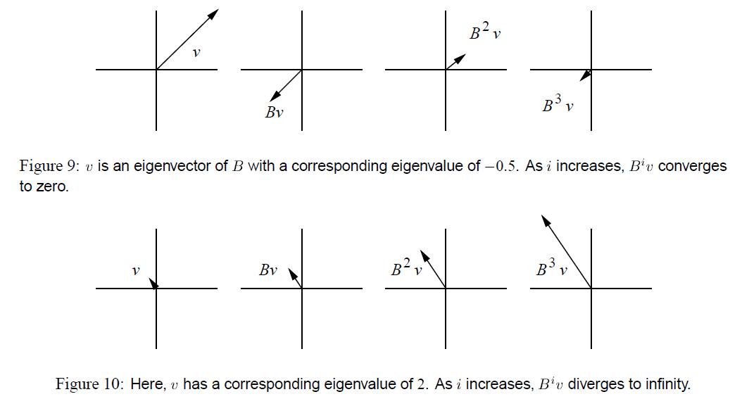

Slide 17
If the function involves the inverse of the matrix and the eigenvalue happens to be zero, we can always add a term ηI to the original matrix to remove the singularity.
The modified matrix has the eigenvalue λ_{i} − η for the corresponding eigenvector x_{i} .
The eigenvalue of the original matrix is recovered by taking η → 0 after the problem is solved.
Based on this property of nondefective matrices, we can construct a recursion: (Iterative method)
To extract the eigen value that is closest to the parameter μ, and N_{k} is a normalization constant to ensure

Slide 18
Eigen Values of a Hermitian matrix
In many physical problems, the matrix is Hermitian.
Complex conjugate of the transpose matrix equals the matrix itself.
Three important properties:
the eigenvalues of a Hermitian matrix are all real;
the eigenvectors of a Hermitian matrix can be made orthonormal;
a Hermitian matrix can be transformed into a diagonal matrix with the same set of eigenvalues under a similarity transformation of a unitary matrix that contains all its eigenvectors.
How do we implement complex matrix in our code?

Slide 19
the eigenvalue problem of an n × n complex Hermitian matrix is equivalent to that of a 2n × 2n real symmetric matrix.
A = B + iC,
B and C are the real and imaginary parts of A,
If A is Hermitian,
B_{ij} = B_{ji}
C_{ij} = -C_{ji}
eigenvector z in a similar fashion, we have z = x + iy.
(B + iC)(x + iy) = λ(x + iy)
Therefore, we only need to solve the real symmetric eigen value problem if the matrix is Hermitian.

Slide 20
(1) use an orthogonal matrix to perform a similarity transformation of the real symmetric matrix into a real symmetric tridiagonal matrix;
a matrix that has nonzero elements only on the main diagonal, the first diagonal below this, and the first diagonal above the main diagonal.
(2) solve the eigenvalue problem of the resulting tridiagonal matrix.

Slide 21
The similarity transformation preserves the eigenvalues of the original matrix,
the eigenvectors are the columns or rows of the orthogonal matrix used in the transformation.
Householder method.
Givens method.
The most commonly used for tridiagonalizing
achieved with a total of n − 2 consecutive transformations, each operating on a row and a column of the matrix.

Slide 22
The transformations can be cast into a recursion:
for k = 1, 2, . . . , n − 2, where O_{k} is an orthogonal matrix that works on the row elements with i = k + 2, . . . , n of the kth column and the column elements with j = k + 2, . . . , n of the kth row. The recursion begins with A⁽⁰⁾ = A.
It is an O(N) algorithm.
Storage advantages.

Slide 23
Here:
Where the ith component of the vector w_{k} is given by
with

Slide 24
Provided in standard math libraries. So we don’t have to reinvent the wheel here. Just take the code from most standard math libraries.
After we obtain the tridiagonalized matrix, the eigenvalues can be found using one of the root search routines available.
Note that the secular equation |A − λI| = 0 is equivalent to a polynomial equation p_{n}(λ) = 0.
Because of the simplicity of the symmetric tridiagonal matrix, the polynomial p_{n}(λ) can be generated recursively with:

Slide 25
Where a_{i} = A_{ii} and b_{i} = A_{ii+1}=A_{i+1i}.
The polynomial is given from the submatrix of A_{jk} with j, k = 1,2…,i with the starting value p₀(λ) =1
And p₁(λ)=a_{1 - λ}.

Slide 26
In principle, we can use any of the root searching routines to find the eigenvalues from the secular equation
as soon as the polynomial is generated.
However, two properties associated with the zeros of p_{n}(λ) are useful in developing a fast and accurate routine to obtain the eigenvalues of a symmetric tridiagonal matrix.
Will not be covered in this lecture. If interested, you can read T. Pang book.

Slide 27
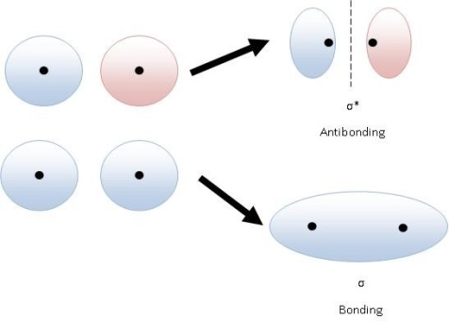
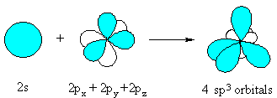
An Overview on Inter-atomic Potentials (CONTINUED)
Covalently bonded Solids: Semiconductors
Bonding and Antibonding

Slide 28
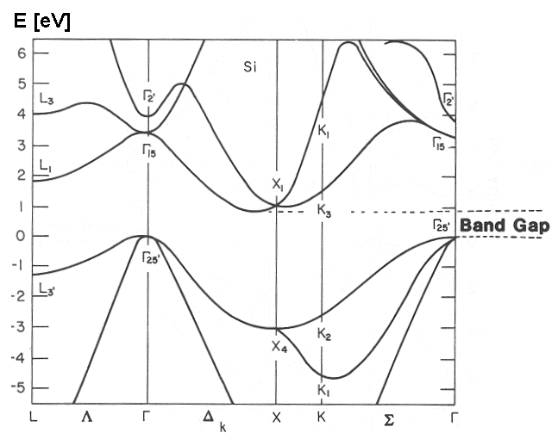
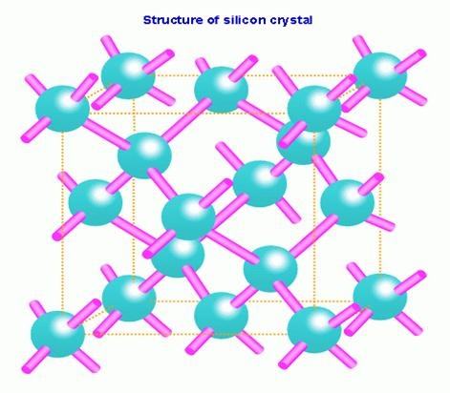
Silicon
studied extensively
important for the semiconductor industry.
forms bonds with the nearest 4 atoms with a local tetrahedron structure.
unlikely to ever come out of a pair potential
A higher order many-body terms has to be included in the potential!

Slide 29
One well-known potential function for silicon is the Stillinger-Weber potential
Phys. Rev. B 31, 5262 (1985).
SW contains an explicit term
forces the angle between the bonds of nearby atoms to stay close to 109 degrees and has been adjusted to giving roughly the lattice constant, the cohesive energy, the melting point and liquid structure.

Slide 31
Another popular potential function for Si (as well as Ge and C) is the Tersoff potential [Phys. Rev. B 39, 5566 (1989).]
a review article Balamane, Phys. Rev. B, 40, 2250 (1992) describing how well various potentials work on silicon.
the potentials, even if they have been carefully tuned, do not really describe all aspects of pure silicon terribly well.
Car-Parrinello technique is viewed as an advance (even though it is slow). One gets a better (but still not perfect) potential, without having to adjust lots of parameters.
Tight-binding potentials are another possible semi-empirical functional forms for treating semiconductors.

Slide 32
Metals
How about the metals?
Metals are characterized by a rare gas shell plus a number of valence electrons.
Pair potentials do not work terribly well because the electrons are very much delocalized.
If one does use a pair potential, it must be softer than the Lennard-Jones form, for example a Morse potential (sum of exponentials.)
The major problem with pair potentials for solid metals is that they have no environmental dependence so that a bulk atom is too much like a surface atom.

Slide 33
One popular empirical potential for metals is the embedded-atom-method (EAM) potential. It is based on the basic idea of jellium model that “metallic bonding” involves ions in an electron sea (jellium) so the total potential energy is the sum of direct ion-ion interaction
(for example to keep to ion cores from overlapping) and the interaction between an ion and the electron sea.
One assumes that locally there is an electron charge density coming from the nearby ions and that the energy and interaction are some function of this density.
This later term is then a true many-body potential.
The EAM potential works well for spherically symmetric atoms such as Cu, Al, Pb. Some references are Daw and Baskes, Phys. Rev. B 29, 6443 (1984) and Foiles, Baskes and Daw, Phys. Rev. B 33, 7983 (1986).
Tight-binding potentials are another possible functional forms for treating metals, especially for transition-metal solids.

Slide 34
Metal: EAM potential:

Slide 35
Biomolecular Sytems
For other systems there are extensive codes which handle real biomolecular systems (GROMOS, CHARM, AMBER ...) They use an experimental data base and put in specific terms for bond lengths, bond angles, torsion angles. etc.
complicated because they have to distinguish between many local bonding arrangements!
Even so, one should never fully trust the accuracy of the empirical potentials.
The errors can still be quite large even if a lot of data has been put in. This is because the potential surface is so highly dimensional and there are so many different possible combinations of atoms that experiment can only hope to sample a very few of them.

